Slide 1
Car Rental Application
Anti-Software Software Club (Team 5)
Mason Francis - Frontend/Management
Caleb Jeppson - Backend Developer
Jack Jones - Frontend Developer
Andrew Rolfe - Team Lead

Slide 2
Project Overview
Car rental management system
Product cost tiers
High - 70s cars
Middle Ground - Mid-level modern cars
Low - Economy cars

Slide 3
Project Overview - Foundational Structure
Back end
Python
Django framework
SQLite database
Front end
Bootstrap 5
Custom colors in CSS

Slide 4
Project Overview
Project design, function, and layout was driven by requirements given
Customer follows this process:
Log in/create account
Select reservation dates and pricing tier on home page
Select a specific vehicle
Confirm reservation w/ option for insurance
Customer may also manage their account from the account page

Slide 5
Requirement - Economy of Things
From the Requirements document:
“A manager can pay and change the status of employees”
“Employees can reserve vehicles, lo-jack and pick up targeted vehicles, and submit an "hours worked" request to the manager to be paid”
“Cars cannot be double rented”
Customer “Can rent vehicles”
The “Things”:
Vehicles
Reservations
Hours
Money

Slide 6
Requirement - Economy of Things
High Level Design:
Some “things” in the economy have distinct objects in the database (vehicles, reservations)
Others exist only as a field in other database objects (hours, money)
All of these have to be tracked to make sure the economy is preserved
E.g. money can’t spontaneously appear in the system - it must enter the economy only at approved points
One part of defining this was UML class diagrams, showing which “things” were database objects and which were properties of objects
Also, how these things relate to the actors in the system

Slide 7
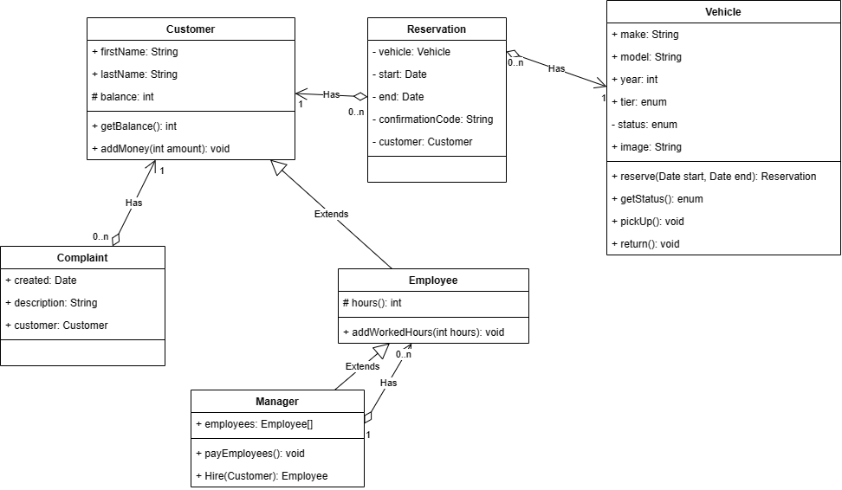
Requirement - Economy of Things
Notes:
This diagram shows the classes we implemented and their relationships. The way the economy is preserved is as follows: vehicles are distinct instances stored in the database. So, too, are reservations. New instances are only created through specific, approved ways - a reservation, for example is created by the app only if several conditions are met. The vehicle must be available, the customer must have adequate balance to pay for it, and they must go through the forms on the site. Once the reservation is created, it is stored and can be found by querying the database, so this “thing” in our economy doesn’t simply disappear. Money, on the other hand, has no distinct database instances, but it is also tracked. It can only enter the economy by a user adding to their balance on the account page, and transfers increase the balance of the recipient by the exact amount that it decreases the balance of the payer.

Slide 8
Requirement - Economy of Things
Final implementation was generally good, but there are some interesting economic “quirks”:
Money may enter the system but can never leave
Money spent on reservations and insurance goes to the manager
From there, the manager may spend it paying their employees, or buying reservations of their own
If they buy their own reservations, the money just goes right back to them
If it goes to their employees, those employees can spend it on reservations, and it again flows to the manager
Future feature: withdraw from balance
Alt - direct deposit into an employee’s bank account, rather than their Customer account
Incorporate with real-life bank accounts - high security requirements
Out of the scope of this project

Slide 9
Requirement - Manager Abilities
Managers can
Add and fire employees
Pay employees
Address complaints
Manage employee hours
Check reservations

Slide 10
Requirement - User Accounts
From Requirements Document:
“Users are able to log in”
Three types of users: Customers, Employees, Managers
Different permission:
“A manager can pay and change the status of employees, and resolve filed complaints from customers”
“Employees can reserve vehicles, lo-jack and pick up targeted vehicles, and submit an "hours worked" request to the manager to be paid”
“Customers may only interact with their own balances and active reservations”
Managers are also employees, and both managers and employees can act as customers

Slide 11
Requirement - User Accounts
High level design: UML class diagram
Manager inherits from employee inherits from customer (Object-Oriented principles)
Looks simple enough on paper, but implementing it brought up some unforeseen challenges
Use of Django’s built-in User model
Inherit from and override the default with the extended User model? Overcomplicated
Our solution: use aggregation (Customer has a User, rather than is a User)
Inheritance of Django models turned out to not work exactly as expected
How are inherited objects stored in the database?
Docs describe it like aggregation under the hood
Some unexpected behaviors came up, but were ultimately resolved or avoided

Slide 12
Requirement - User Accounts
Final implementation:
Manager inherits from Employee inherits from Customer
Customer has a user - forced one-to-one mapping
That is, multiple customers cannot share a user
Customer object automatically created when a user signs up
Employee and managers manually created via Django Admin
Future feature opportunity:
In-app way to hire employees

Slide 13


Slide 17
Resources
https://learndjango.com/tutorials/django-signup-tutorial
https://learndjango.com/tutorials/django-login-and-logout-tutorial
https://getbootstrap.com/docs/5.3/getting-started/introduction/
https://docs.djangoproject.com/en/4.2/
https://mdbootstrap.com/docs/standard/navigation/navbar/
https://www.w3schools.com/django/

Slide 18
Questions?

